Slide 1
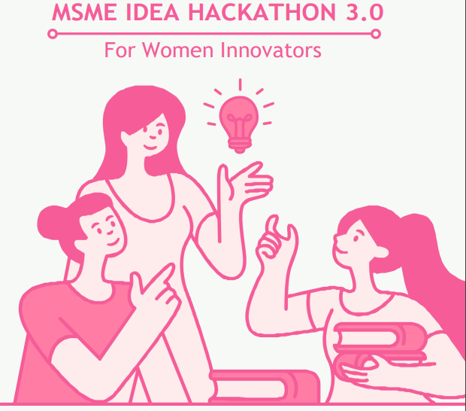
Assurance
I assure that the Ideas which is not already exist
I assure that the Ideas is not infringement/theft
I assure that the Ideas which are not against established scientific theories/norms
SIGNATURE
Anisa F

Slide 2
Title of proposed idea/innovation
Title: Treasure Traders : Journey through India
Team Leader Name: Anisa F
Ref No. : INC23CTN021728

Slide 3
Summary of the idea. (Technical solution) :
Game Concept: Develop a skill-based board game called " Treasure Traders : Journey through India " that combines entertainment and education.
Cultural Immersion: Integrate diverse Indian cultures, traditions, and goods into gameplay for an authentic experience.
Realistic Trading Mechanics: Simulate market dynamics and economic principles to provide strategic decision-making challenges.
Interactive Learning: Promote critical thinking by educating players about Indian geography, culture, and trading practices.
Customizable Gameplay: Adapt to different skill levels with adjustable difficulty and rule variations.
Cross-Cultural Exchange: Encourage negotiation skills and appreciation for diverse perspectives.
Replayability and Variety: Offer endless entertainment with numerous city cards and randomized gameplay.
Market Potential: Target educational institutions, tourism, retail, and online platforms.
Quality Production: Ensure high-quality components, artwork, and packaging even when we use recycled products.
Future Expansion: Plan for potential expansion packs, digital versions, and collaborations.

Slide 4
Main Problem Being Addressed in the Project (Highlight the specific problem & solution addresses)
Cultural Immersion: The game integrates diverse Indian cultures for an authentic experience.
Realistic Trading: Simulates market dynamics, aiding strategic decisions.
Interactive Learning: Fosters critical thinking via enjoyable gameplay about Indian culture and trading.
Customizable Gameplay: Adapts to skill levels with variable rules.
Cross-Cultural Exchange: Encourages communication, negotiation, and appreciation.
Replayability: Unique city cards and randomized play offer endless entertainment.
How simple or complex will the idea’s execution or implementation be?
Creating the " Treasure Traders : Journey through India " board game involves a moderate level of complexity. Balancing gameplay mechanics, creating authentic artwork, incorporating accurate educational content, playtesting, production, distribution, marketing, and potential expansions require careful planning and execution.

Slide 5
What are the risk factors involved in executing the idea?
Executing the " Treasure Traders : Journey through India " idea involves risks such as cultural sensitivity, accurate educational content, game balance, competition, manufacturing delays, market acceptance, legal issues, production quality, logistics, and changing trends. To manage these risks, thorough research, expert collaboration, playtesting, and adaptability are essential.
How soon could the idea be put into operation? (TRL of the prototype)
It has been conceptualized with a clear vision, but the execution process, including design, artwork, playtesting, production, and distribution, has not yet begun. Therefore, the Technology Readiness Level (TRL) of the prototype is TRL 2.

Slide 6
How much investment would you need for prototyping the Idea?
Investment Category | Considerations | Investment Amount
Game Design and Development | Hiring designers and developers, software and equipment | 180000
Artwork and Illustrations | Professional artists, licensing fees, revisions | 1,00,000
How is this project made and used (how the innovation is implemented?)
The " Treasure Traders : Journey through India " project is implemented through these,
Conceptualization: Formulate the game idea, mechanics, and educational content.
Design: Create game components, artwork, and mechanics.
Prototyping: Develop a playable prototype for testing.
Playtesting: Refine mechanics based on player feedback.
Production: Source materials and manufacture components.
Marketing: Promote the game through various channels.
Distribution: Make the game available for purchase.
Engagement: Build a community and gather feedback.
Future Development: Consider expansions and adaptations.

Slide 7
1. Novel & innovative value:
In "Treasure Traders : Journey through India " the board game combines cultural immersion, realistic trading mechanics, interactive learning, and customizable gameplay in an engaging and educational experience that ensures its novel and innovative value.
2. Useful to the society:
The " Treasure Traders : Journey through India " board game is beneficial to society by promoting cultural understanding, geographical awareness, economic literacy, critical thinking, and cross-cultural exchange. It serves as an educational tool, enhances bonding, and contributes to cultural tourism, all while offering an enjoyable way to learn about India's culture and trading practices.

Slide 8
3. Reduce the cost of living, product or process:
As this board game focuses on education, "Treasure Traders: Journey through India" does not directly address reducing the cost of living.
4. Improve quality of life and provide convenience to living standards
The " Treasure Traders : Journey through India” provides an immersive, educational experience that is designed to foster cultural understanding and critical thinking which enhances the quality of life.

Slide 9
5. Clean & green energy initiative:
This idea takes a step towards sustainability by incorporating a recyclable and eco-friendly design for the game components, aligning with clean and green energy initiatives.
6. Innovative value proposition of products/ services being offered:
Our innovative board game uniquely combines cultural immersion, strategic gameplay, and educational content, providing an enriching entertainment experience that fosters cross-cultural appreciation.

Slide 10
7. Ease of availability of the resources used in the product to ensure ease of scalability:
The resources for our board game are easily available, ensuring scalability and widespread availability.
8. Commercial/Technical/Financial viability :
Our board game is commercially viable, offering an innovative and educational product that appeals to a diverse audience.

Slide 11
9. Climate mitigation measures:
Our idea doesn't directly involve in climate mitigation measures.
10. Status of intellectual property :
The status of intellectual property is protected by applying a patent for our product.

Slide 12
11. Indigenization of imported items:
Indigenization Boost: The game showcases the diversity of Indian cities and goods, promoting local culture and products.
Pride in Craftsmanship: Highlights indigenous items, fostering pride in local resources and craftsmanship.
Support for Goods: Trading virtual representations indirectly supports the appreciation of domestic products.
Interest in Authenticity: Spurs interest in Indian goods, strengthening the local market for indigenous items.
Educational Awareness: Raises awareness about locally produced items and sustainable consumption.
Economic Growth: Promotes local industries, boosting the economy and domestic market.
Deeper Heritage Connection: The game deepens the connection to Indian heritage and representative products.

Slide 13
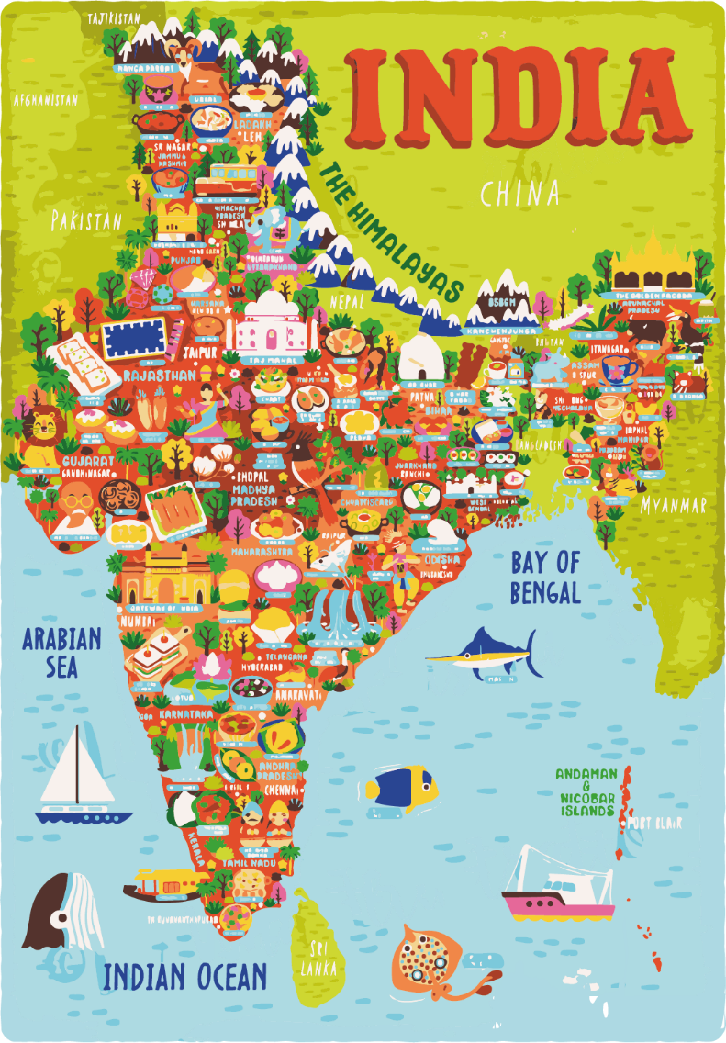
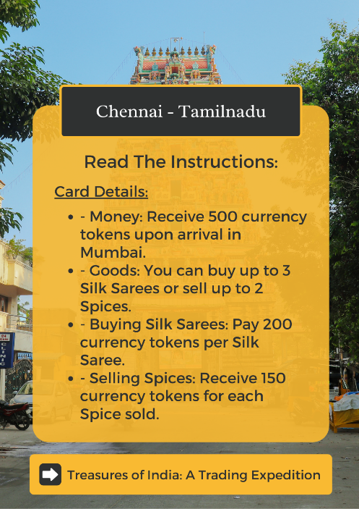
Pictorial representation

Slide 14
Activity-wise break
Particular/Item | Total idea project cost (Rs. In lakh) | Amount GOI assistance (Rs. In lakh) | Incubatee share (Rs. In lakh) (Not for Students)
Technology related Expenditure towards machine usage charges etc., Electricity charges, Procurement of raw material , testing/Calibration charges, other charges essential for development of idea Max (10.00) lakh. | 4,50,000 | 4,50,000
Charges for mentor/handholding supporting team Max (3.00) lakh. | 2,00,000 | 2,00,000
Travelling Expenses or any other item not coverd as above may be allowed as per need for development of the idea Max ( 2.00) lakh. | 1,20,000 | 1,20,000
Total | 7,70,000 | 7,70,000

Slide 15

Solve any existing problems for MSMEs

